Slide 1
Disciplinary Discussions Using Text Sets
GRADE 5: TEXT SET B
INTERACTING WITH TEXTS: Lessons 1B-6B

Slide 2

REVIEW CONSTRUCTIVE
CONVERSATION SKILLS
LESSON 1B

Slide 3

ELD OBJECTIVE
In this lesson, we will...
  have a conversation with a partner and in a small group
  collaborate with teammates to create an infographic about Constructive Conversations
  present the infographic to another team
  give and receive feedback
  start an artifacts folder
STUDENT FRIENDLY ELD OBJECTIVES
Notes:
COMMUNICATE THE PURPOSE OF THE LESSON - SHARE LESSON OBJECTIVES WITH STUDENTS

Slide 4

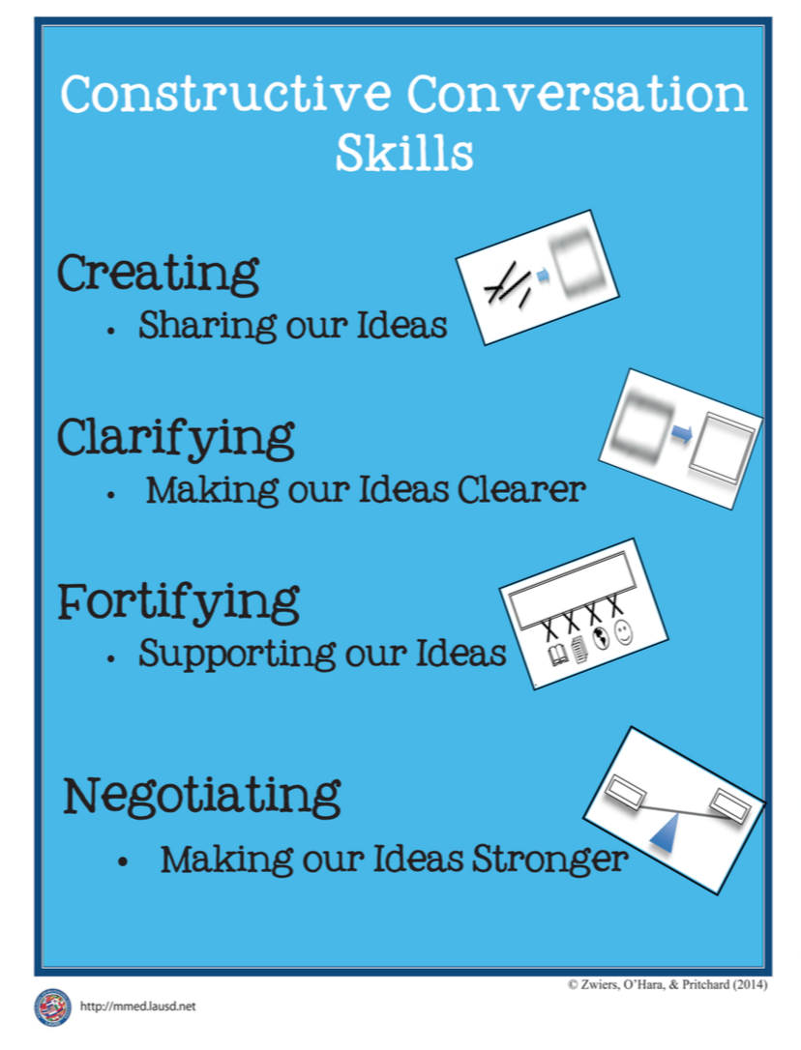


What information might you include in an infographic about the Constructive Conversation Skills?
TURN & TALK
REVIEW PRIOR KNOWLEDGE
Notes:
REVIEW CONSTRUCTIVE CONVERSATION SKILLS AND CHARACTERISTICS OF INFOGRAPHICS

Slide 5
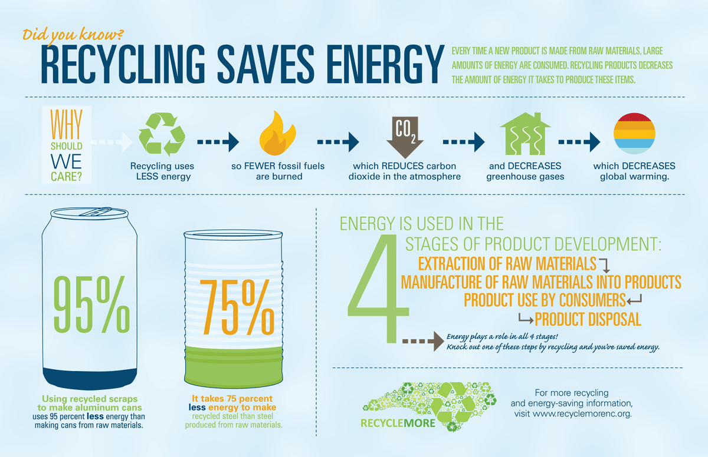
What do you know about infographics? What is the purpose?
Let’s review what we know about infographics:
How is the information organized?
What text elements (visuals and words) are included?
How is language used to present ideas?
MODEL/GUIDED PRACTICE
Notes:
Teacher will guide the students to revise their knowledge of Infographics considering the following three questions:
How is the information organized?
What text elements (visuals and words) are included?
How is language used to present ideas?
Students will to work in pairs addressing one question at a time. (Next three slides)

Slide 6
How is the information organized?
Sections are logically organized and connected
Title presents a main idea in the form of a question
Example 1: Gives evidence to answer the question
Example 2: Poses another question and explains the answer by showing a process
Example 3: Provides data as supporting evidence
Example 4: Builds on Example 3
Source: Commitment to learn; website
MODEL/GUIDED PRACTICE
Notes:
HAVE STUDENTS STUDY THE INFOGRAPHIC AND ADDRESS THE FOLLOWING QUESTION:
How is the information organized?

Slide 7
What text elements are included?
Title clearly conveys the main idea/topic
Visuals clearly support the main idea
Words build on the visuals
Data is represented through the visuals in a creative way
Color and space represent the main idea/topic
MODEL/GUIDED PRACTICE
Notes:
HAVE STUDENTS STUDY THE INFOGRAPHIC AND ADDRESS THE FOLLOWING QUESTION:
What text elements are included?

Slide 8
How is language used to present an idea?
Did YOU know? – the use of the word YOU implies the reader’s responsibility & a call to action
Questions – pose questions that capture the main idea; they engage the reader to find out about the topic
Strategic Use of Words/Phrases
  Synonyms – this example uses synonyms that repeat the main idea (LESS, FEWER; REDUCES, DECREASES, etc.)
  Key words about the topic are repeated (energy, raw materials, recycling, etc.)
MODEL/GUIDED PRACTICE
Notes:
HAVE STUDENTS STUDY THE INFOGRAPHIC AND ADDRESS THE FOLLOWING QUESTION:
How is language used to present an idea?

Slide 9
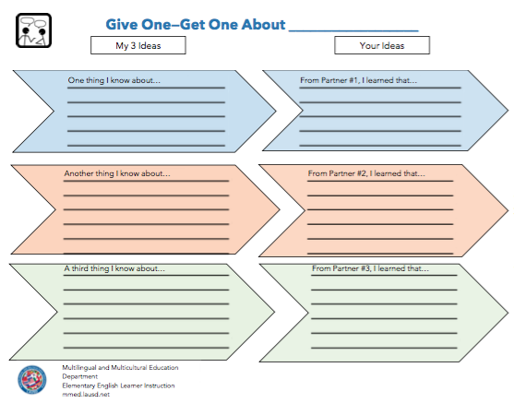
What information will you include in an infographic about the Constructive Conversation Skills?
We will use this graphic organizer to take notes about the following guiding questions:
How will you organize the information?
What text elements (visuals and words) will you include?
What language will you use?
MODEL/GUIDED PRACTICE - GIVE ONE-GET ONE
Notes:
Now you will work with your partners to review all you know about the Constructive Conversation Skills. We will use the Give One-Get One Graphic Organizer to think and take notes about the following prompt:
What information will you include in an infographic about the Constructive Conversation Skills?
Distribute the Give One-Get One Graphic Organizer to students. Display the directions for the Give One-Get One Protocol.

Slide 10
GIVE ONE-GET ONE PROTOCOL
Think about the prompt.
Write one idea in each box on the left under the heading “My 3 Ideas.”
Turn and face the teacher when ready to share.
At the signal, find Partner #1.
With your partner “Give One” idea and listen to “Get One” idea.
After you have both shared, write the new idea in the “Get One” column and write the initials of the person who gave the information.
At the signal, find Partner #2. Follow steps 5-6 with this partner.
At the signal, find Partner #3. Follow steps 5-6 with this partner.
GIVE ONE-GET ONE PROTOCOL DIRECTIONS
Notes:
Say, Let’s read the directions for the Give One-Get One Protocol.

Slide 11

Think about the prompt.
What information will you include in an infographic about the Constructive Conversation Skills?
Hmmm. So, I’m going to use the poster to remember what I know about the skills. Now, think about the guiding questions:
How will you organize the information?
What text elements (visuals and words) will you include?
What language will you use?
MODEL/GUIDED PRACTICE - TEACHER THINK ALOUD
Notes:
TEACHER THINK ALOUD to review and model the Give One-Get One Protocol.
The first step is, “Think about the prompt.” The prompt is: What information will you include in an infographic about the Constructive Conversation Skills?
Hmmm. So, I’m going to use the poster to remember what I know about the skills. Now, think about the guiding questions:
How will you organize the information?
What text elements (visuals and words) will you include?
What language will you use?

Slide 12
Step 2 is to write one idea in each box on the left under the heading, “My 3 Ideas.” I will write my ideas here
SKILLS INFOGRAPHIC
organizing an infographic is…
Write one idea in each box on the left under the heading “My 3 Ideas.”
Turn and face the teacher when ready to share.
text elements in an infographic is…
the language in an infographic is…
MODEL/GUIDED PRACTICE - GIVE ONE-GET ONE - CONVERSATION NORMS
Notes:
TEACHER THINK ALOUD continues:
Step 2 is to write one idea in each box on the left under the heading, “My 3 Ideas.” I will write my ideas here (point to the first box in the graphic organizer and complete the statement, “One thing I know about…” organizing an infographic is…

Slide 13
SKILLS INFOGRAPHIC
At the signal, find Partner #1.
With your partner Give One of your ideas and listen to Get One idea from your partner.
After you have both shared, write the new idea in the “Your Ideas” column and write the initials of the person who gave the information.
MODEL/GUIDED PRACTICE - GIVE ONE-GET ONE - CONVERSATION NORMS
Notes:
TEACHER THINK ALOUD continues:
At the signal, I find Partner #1. I look for someone who does not have a partner and is ready to share.
Model following steps 5 and 6 from the Give One, Get One directions with a student.

Slide 14
SKILLS INFOGRAPHIC
At the signal, find Partner #2. Follow steps 5-6 with this partner.
At the signal, find Partner #3. Follow steps 5-6 with this partner.
MODEL/GUIDED PRACTICE - GIVE ONE-GET ONE - CONVERSATION NORMS
Notes:
Say, Remember to address the prompt:
What information will you include in an infographic about the Constructive Conversation Skills?
Once everyone has given and received information, lead students in a whole-group discussion of the information they have shared. Students should annotate/edit their notes when ideas are incorrect, such as drawing a line through them.

Slide 15

  CREATE AN INFOGRAPHIC
TASK:
Collaborate with your teammates to create an infographic about Constructive Conversations Skills
Present your ideas as a team
Form triads
Each of you needs your completed “Give One-Get One” Graphic Organizer
Each triad needs chart paper and writing tools
Take turns sharing your ideas using your graphic organizer
Negotiate which ideas you will include in your infographic
Each member must take an active role:
  Wordsmith
  Graphic Artist
  Editor
All members will present
CRITERIA:
Presents an original idea about Constructive Conversations
Provides at least 3 examples and/or evidence that support the idea
Examples/evidence make use of visuals, data, and precise language
All ideas are logically organized and connected.
PREPARE FOR THE TASK
Notes:
Direct students to form triads.
Explain the task and review criteria to create an infographic as a team.

Slide 16




ORAL PRESENTATION
FISHBOWL MODEL
TASK:
Collaborate with your teammates to create an infographic about Constructive Conversations Skills. Present your ideas as a team.
Listen actively as three of your peers model how to present the infographic they created.
Did they include an original idea about Constructive Conversations Skills? How do you know?
Did they provide at least 3 examples and/or evidence that support the idea? How do you know?
Did the examples/evidence make use of visuals, data, and precise language? How do you know?
Were all ideas logically organized and connected? How do you know?
FORMATIVE ASSESSMENT– TEACHER COLLECTS LANGUAGE SAMPLE SPF OOAT – MULTIPLE SPEAKERS
Notes:
SELECT THREE STUDENTS TO ORALLY PRESENT THEIR INFOGRAPHIC TO THE CLASS.
COLLECT A LANGUAGE SAMPLE USING THE SPF OOAT.
USE THE LISTED CRITERIA TO DEBRIEF THE FISHBOWL AND MODEL GIVING FEEDBACK TO STUDENTS.

Slide 17
ORAL PRESENTATION
TRIAD PRESENTS TO ANOTHER TRIAD
TASK:
Present your ideas as a team.
Give and receive feedback.
Find another Triad. Take turns presenting.
Listen for the following:
Did they include an original idea about Constructive Conversations Skills? How do you know?
Did they provide at least 3 examples and/or evidence that support the idea? How do you know?
Did the examples/evidence make use visuals, data, and precise language? How do you know?
Were all ideas logically organized and connected? How do you know?
FORMATIVE ASSESSMENT– TEACHER COLLECTS LANGUAGE SAMPLE SPF OOAT – MULTIPLE SPEAKERS
Notes:
HAVE EACH TRIAD TEAM UP WITH ANOTHER TRIAD. EACH TRIAD SHOULD TAKE TURNS PRESENTING AND GIVING/RECEIVING FEEDBACK.

Slide 18
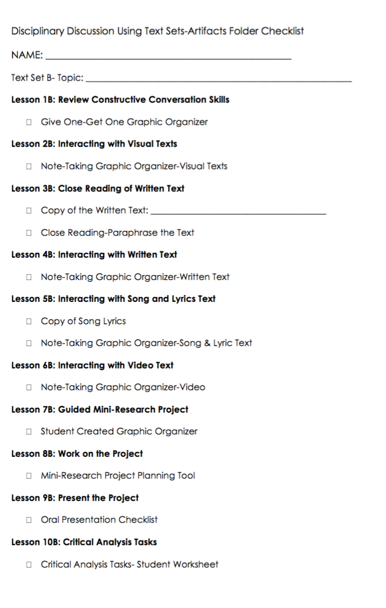

Artifacts Folder
✓
Place your Give One-Get One Graphic Organizer in your Artifacts Folder
Use the checklist to mark each task as you complete it
Notes:
Provide each student with a folder to keep her/his artifacts.

Slide 19

REVIEW ELD OBJECTIVE & SELF-ASSESS
In this lesson, you…
  had a conversation with a partner and in a small group
  collaborated with teammates to create an infographic about Constructive Conversations Skills
  presented the infographic to another team
  gave and received feedback
  started an artifacts folder
Think…
    What helped you create and present your infographic?
Work with your Constructive Conversation partner to:
Identify one thing that you did well and one thing you want to improve
Share and explain to your partner
TURN & TALK
TURN & TALK - THEN WHOLE GROUP DISCUSSION
Notes:
After students have had a few minutes to discuss with a partner, call on one or two individuals to share out with the whole group.

Slide 20
INTERACTING WITH VISUAL TEXTS
LESSON 2B

Slide 21
ELD OBJECTIVE
In this lesson, you will...
  listen actively to a Model Constructive Conversation about visual texts
  have a Constructive Conversation with a partner
  collaborate with a partner to take notes using a graphic organizer
  add to your artifacts folder
STUDENT FRIENDLY ELD OBJECTIVES
Notes:
COMMUNICATE THE PURPOSE OF THE LESSON - SHARE LESSON OBJECTIVES WITH STUDENTS

Slide 22
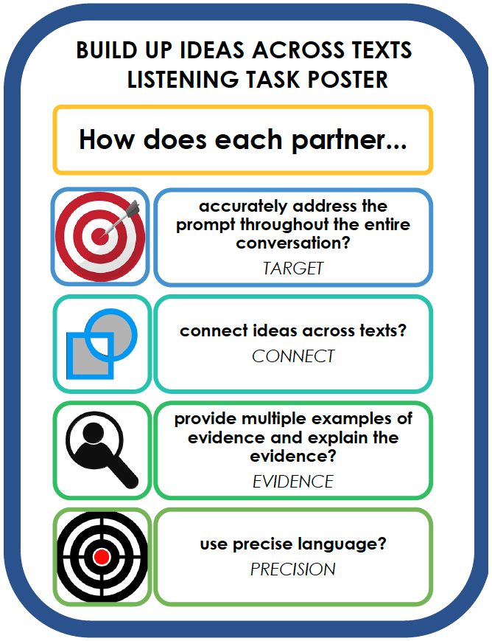
How do we build up an idea together?
TARGET – Both partners make an initial claim that answers the prompt. They continue building their ideas and answer the prompt with every turn.
CONNECT – Both partners need to explain how an idea in one text connects to an idea in another text.
EVIDENCE – Both partners cite a variety of connected examples and explain how these support their claims.
PRECISION – Both partners use precise language (vocabulary from the texts) to explain their ideas.
REVIEW – CONVERSATION PATTERN
Notes:
Display the Conversation Pattern Poster and refer to it as you explain EACH PART.
WE HAVE ALREADY LEARNED HOW TO USE THE CONVERSATION PATTERN. REMEMBER THAT ALL OF THE ELEMENTS IN THE CONVERSATION PATTERN WILL HELP YOU HAVE STRONGER CONVERSATIONS.

Slide 23
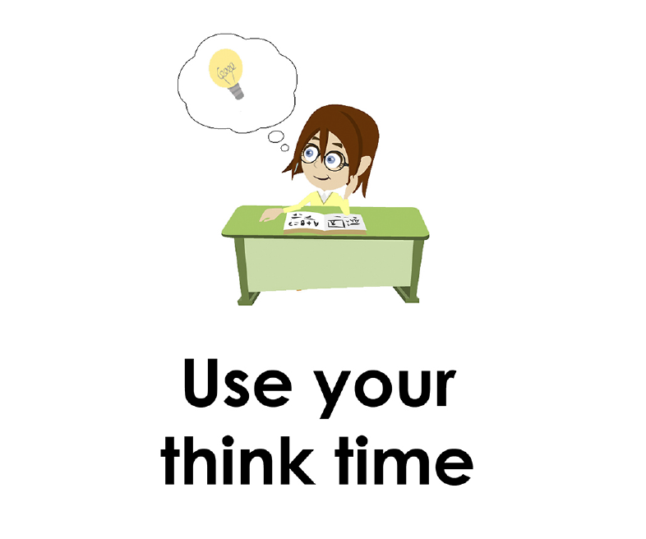
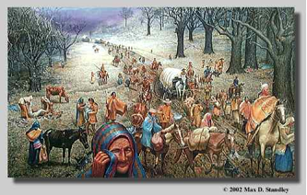
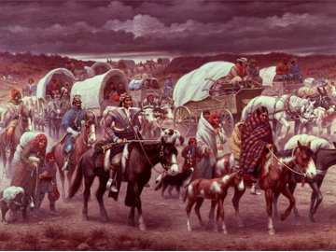
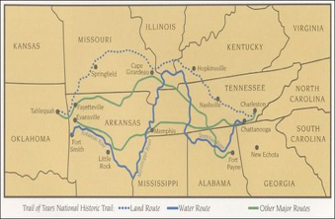
  Use your think time to study the visual texts.
#1
#2
#3
  Prompt: What do you notice? Make connections across the texts. Cite details to CLARIFY and FORTIFY your observations.
Notes:
DISPLAY THE VISUAL TEXTS ONLY. MODEL USING THINK TIME AND GIVE STUDENTS ENOUGH THINK TO TO STUDY THE TEXTS AS WELL.

Slide 24
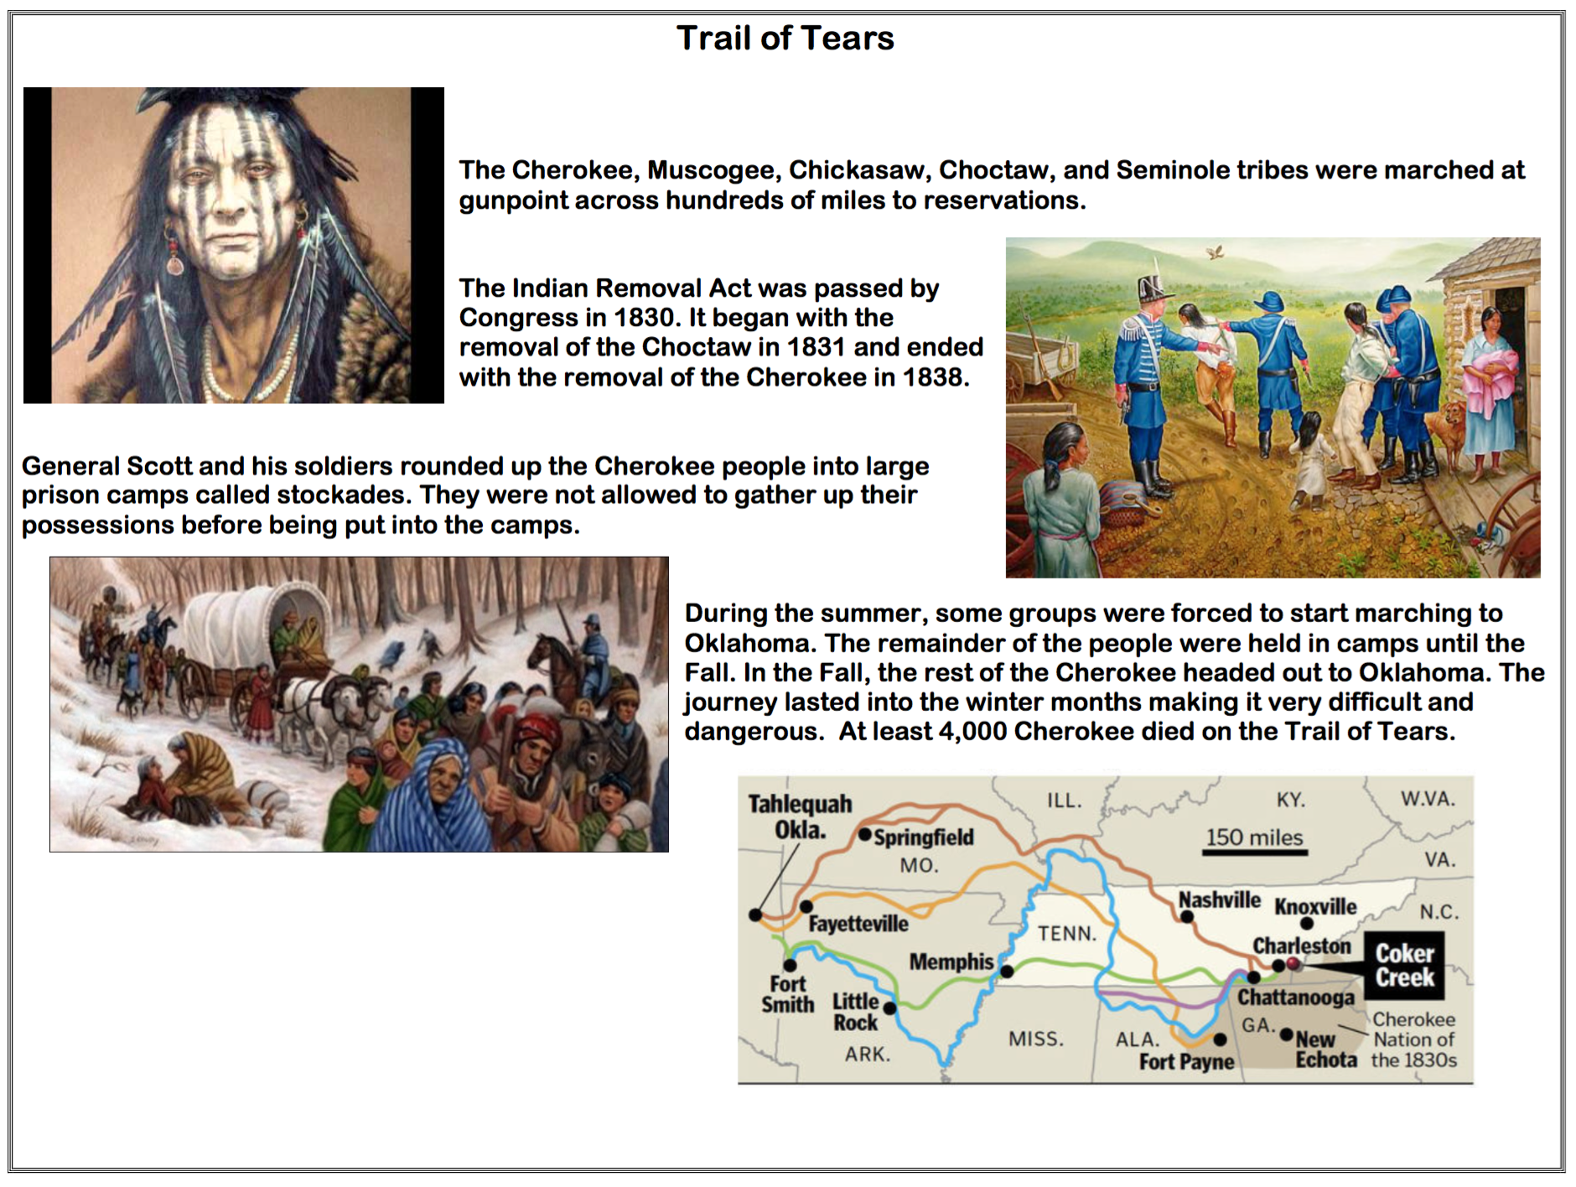
  Use your think time to study the visual texts.
#1
#2
#3
#4
  Prompt: What do you notice? Make connections across the texts. Cite details to CLARIFY and FORTIFY your observations.
Notes:
DISPLAY THE VISUAL TEXTS & INFOGRAPHIC. MODEL USING THINK TIME AND GIVE STUDENTS ENOUGH THINK TO TO STUDY THE TEXTS AS WELL.

Slide 25
Listen Actively
Number off from 1-4
Each of you will listen actively for one specific criterion:
  1s – How does each partner accurately address the prompt throughout the entire conversation?
  2s - How does each partner combine ideas across texts?
  3s - How does each partner provide multiple examples of evidence ?
  4s - How does each partner utilize academic and domain specific vocabulary – precise language?
PREPARE FOR ACTIVE LISTENING
Notes:
Review the Listening Task Poster and assign each student a focus to prepare for Active Listening

Slide 26

Listen to the Model
#1
#2
#3
#4
  Prompt: What do you notice? Make connections across the texts. Cite details to CLARIFY and FORTIFY your observations.
Notes:
DISPLAY THE VISUAL TEXTS & INFOGRAPHIC. MODEL USING THINK TIME AND GIVE STUDENTS ENOUGH THINK TO TO STUDY THE TEXTS AS WELL.

Slide 27

What makes this a Model Constructive Conversation?
SHARE OUT
Let’s share out your findings.
Each of you listened actively for one specific criterion:
  1s – How did each partner accurately address the prompt throughout the entire conversation?
  2s - How did each partner combine ideas across texts?
  3s - How did each partner provide multiple examples of evidence ?
  4s - How did each partner utilize academic and domain specific vocabulary – precise language?
DEBRIEF THE MODEL
Notes:
DEBRIEF THE MODEL
Let’s share out your findings.
Each of you listened actively for one specific criterion:
1s – How did each partner accurately address the prompt throughout the entire conversation?
2s - How did each partner combine ideas across texts?
3s - How did each partner provide multiple examples of evidence ?
4s - How did each partner utilize academic and domain specific vocabulary – precise language?

Slide 28
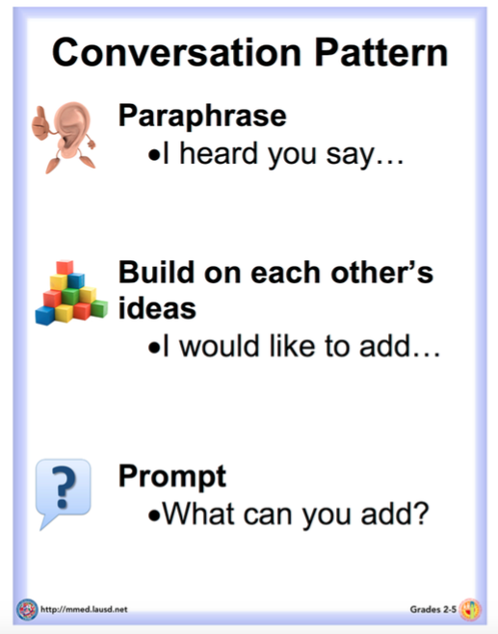
Let’s Review the
Conversation Pattern
Paraphrase:
This means we listen actively and articulate our partner’s thoughts in our own words. Paraphrasing helps us to CLARIFY or make sure we understand our partner’s ideas.
Build on each other’s ideas:
This means that we listen to what our partner says and FORTIFY by adding details and other information to their ideas.
Prompt:
This means we ask questions to continue creating, clarifying, fortifying, or negotiating ideas to have a powerful conversation that helps create new knowledge about the topic.
REVIEW – CONVERSATION PATTERN
Notes:
REMIND STUDENTS OF THE CONVERSATION PATTERN IF NEEDED.
Display the Conversation Pattern Poster and refer to it as you explain EACH PART.
WE HAVE ALREADY LEARNED HOW TO USE THE CONVERSATION PATTERN. REMEMBER THAT ALL OF THE ELEMENTS IN THE CONVERSATION PATTERN WILL HELP YOU HAVE STRONGER CONVERSATIONS.

Slide 29
Listen to the Non-Model
#1
#2
#3
#4
  Prompt: What do you notice? Make connections across the texts. Cite details to CLARIFY and FORTIFY your observations.
  Prompt: What do you notice? Make connections across the texts. Cite details to CLARIFY and FORTIFY your observations.
Notes:
STUDENTS SHOULD LISTEN ACTIVELY TO THE MODEL

Slide 30
Debrief the Non-Model
SHARE OUT
How would you improve the conversation?
DEBRIEF THE NON-MODEL
Notes:
DEBRIEF THE NON-MODEL
Let’s share out your findings.
Each of you listened actively for one specific criterion:
1s – How did each partner accurately address the prompt throughout the entire conversation?
2s - How did each partner combine ideas across texts?
3s - How did each partner provide multiple examples of evidence ?
4s - How did each partner utilize academic and domain specific vocabulary – precise language?

Slide 31

Prepare to Have a Constructive Conversation
Stand Up – Look for a partner
Hand Up – Raise one hand in the air and walk across the room to find a partner
Pair Up – Connect your hand with your partner
STAND UP, HAND UP, PAIR UP STRATEGY
Notes:
Show how to use the Stand Up, Hand Up, Pair Up Strategy to find a new partner. Model looking standing up (Stand Up), raising one hand in the air (Hand Up), and walking across the room to find a partner (Pair Up). Demonstrate how to connect your hand to your partner’s hand to confirm that you’ve selected each other. Have students do the same.

Slide 32
Student Practice - Constructive Conversation
#1
#2
#3
#4
  Prompt: What do you notice? Make connections across the texts. Cite details to CLARIFY and FORTIFY your observations.
  Prompt: What do you notice? Make connections across the texts. Cite details to CLARIFY and FORTIFY your observations.
Notes:
STUDENTS SHOULD PRACTICE HAVING A CONSTRUCTIVE CONVERSATION ABOUT THE VISUAL TEXTS AND INFOGRAPHIC

Slide 33

CONSTRUCTIVE CONVERSATION FISHBOWL MODEL
PROMPT:
What do you notice?
  Make connections across the texts. Cite details to CLARIFY and FORTIFY your observations.
Listen actively as two of your peers model how to have a Constructive Conversation
#1
#2
#3
#4
FORMATIVE ASSESSMENT– TEACHER COLLECTS LANGUAGE SAMPLE SPF 2.0
Notes:
Select two students to Fishbowl Model a Constructive Conversation in front of the class. Students will address the following prompt: What do you notice?
Make connections across the visual texts. Cite details to CLARIFY and FORTIFY your ideas.
Collect a language sample from the two students using the SPF 2.0. The language sample must be at least four turns in length.

Slide 34
DEBRIEF THE FISHBOWL MODEL
PROMPT:
What do you notice?
  Make connections across the texts. Cite details to CLARIFY and FORTIFY your observations.
#1
TURN & TALK
#2
#3
#4
DEBRIEF THE FISHBOWL MODEL
Notes:
USE THE LISTENING TASK POSTER TO DEBRIEF THE FISHBOWL MODEL WITH STUDENTS AND PROVIDE FEEDBACK

Slide 35
Note-Taking Graphic Organizer
Visual Texts & Infographic – Trail of Tears
they had to walk through different states.
You and your partner will think about the ideas you discussed during your Constructive Conversation
You must agree on the four strongest ideas
Each of you will write the same four ideas on your copy of the Graphic Organizer
For example…
MODEL – REVIEW THE CONVERSATION PATTERN
Notes:
GUIDE STUDENTS THROUGH STEP 1 OF THE GRAPHIC ORGANIZER. STUDENTS SHOULD COLLABORATE AND DISCUSS THEIR ANSWERS BEFORE WRITING THEM DOWN ON THEIR PAPERS.

Slide 36
Note-Taking Graphic Organizer
Visual Texts & Infographic – Trail of Tears
they had to walk through different states.
What do the four ideas you selected make you think? Talk to your partner
You must agree on how to complete the following sentence starter:
  We think…
Each of you will write the same response on your copy of the Graphic Organizer
the Native Americans were treated poorly.
MODEL – NOTE-TAKING SKILLS
Notes:
GUIDE STUDENTS THROUGH STEP 2 OF THE GRAPHIC ORGANIZER. STUDENTS SHOULD COLLABORATE AND DISCUSS THEIR ANSWERS BEFORE WRITING THEM DOWN ON THEIR PAPERS.

Slide 37
Visual Texts & Infographic – Trail of Tears
Note-Taking Graphic Organizer
      They walked through different states. Visual texts 3 & 4 show the trail
they had to walk through different states .
Return to the texts and find evidence that supports each idea
You must agree on the evidence and provide an explanation
Each of you will write the same response on your copy of the Graphic Organizer
the Native Americans were treated poorly.
MODEL – NOTE-TAKING SKILLS
Notes:
GUIDE STUDENTS THROUGH STEP 3 OF THE GRAPHIC ORGANIZER. STUDENTS SHOULD COLLABORATE AND DISCUSS THEIR ANSWERS BEFORE WRITING THEM DOWN ON THEIR PAPERS.

Slide 38
Visual Texts & Infographic – Trail of Tears
Note-Taking Graphic Organizer
      They walked through different states. Visual texts 3 & 4 show the trail
they had to walk through different states.
How does the evidence modify your thinking? What do you think now?
Turn and talk to your partner
You must agree on how to complete the following sentence starter:
  We now think…
Each of you will write the same response on your copy of the Graphic Organizer
the Native Americans were treated poorly.
MODEL – NOTE-TAKING SKILLS
Notes:
GUIDE STUDENTS THROUGH STEP 4 OF THE GRAPHIC ORGANIZER. STUDENTS SHOULD COLLABORATE AND DISCUSS THEIR ANSWERS BEFORE WRITING THEM DOWN ON THEIR PAPERS.

Slide 39
Note-Taking
Graphic Organizer
Visual Texts & Infographic – Trail of Tears
      They walked through different states. Visual texts 3 & 4 show the trail
they had to walk through different states.
Based on the evidence from the visual texts, what can you conclude?
Turn and talk to your partner
You must agree on how to complete the following sentence starter:
  Based on the evidence from the visual texts, we can conclude that…
Each of you will write the same response on your copy of the Graphic Organizer
the Native Americans were treated poorly.
the Native Americans suffered during this time.
MODEL – NOTE-TAKING SKILLS
Notes:
GUIDE STUDENTS THROUGH STEP 5 OF THE GRAPHIC ORGANIZER. STUDENTS SHOULD COLLABORATE AND DISCUSS THEIR ANSWERS BEFORE WRITING THEM DOWN ON THEIR PAPERS.

Slide 40
Note-Taking
Graphic Organizer
Visual Texts & Infographic – Trail of Tears
      They walked through different states. Visual texts 3 & 4 show the trail
they had to walk through different states.
What questions do you have?
Turn and talk to your partner
You must agree on how to complete the following sentence starter:
  A question we now have is…
Each of you will write the same response on your copy of the Graphic Organizer
the Native Americans were treated poorly.
the Native Americans suffered during this time.
Who stood up for the Native Americans?
MODEL – NOTE-TAKING SKILLS
Notes:
GUIDE STUDENTS THROUGH STEP 6 OF THE GRAPHIC ORGANIZER. STUDENTS SHOULD COLLABORATE AND DISCUSS THEIR ANSWERS BEFORE WRITING THEM DOWN ON THEIR PAPERS.

Slide 41
Artifacts Folder
Trail of Tears
✓
✓
Place your Note-Taking Graphic Organizer in your Artifacts Folder
Use the checklist to mark each task as you complete it
Notes:
Remind students to keep her/his artifacts in their artifacts folder

Slide 42
REVIEW ELD OBJECTIVE & SELF-ASSESS
In this lesson, you…
  listened actively to a Model Constructive Conversation about visual texts
  had a Constructive Conversation with a partner
  collaborated with a partner to take notes using a graphic organizer
  added to your artifacts folder
Think…
    What helped you take relevant notes?
Work with your Constructive Conversation partner to:
Identify one thing that you did well and one thing you want to improve
Share and explain to your partner
TURN & TALK
TURN & TALK - THEN WHOLE GROUP DISCUSSION
Notes:
After students have had a few minutes to discuss with a partner, call on one or two individuals to share out with the whole group.

Slide 43
CLOSE READING
LESSON 3B

Slide 44
ELD OBJECTIVE
In this lesson, you will...
  read a text closely three times
  have a Constructive Conversation with a partner
  collaborate with a partner to paraphrase a written text
  add to your artifacts folder
STUDENT FRIENDLY ELD OBJECTIVES
Notes:
COMMUNICATE THE PURPOSE OF THE LESSON - SHARE LESSON OBJECTIVES WITH STUDENTS

Slide 45
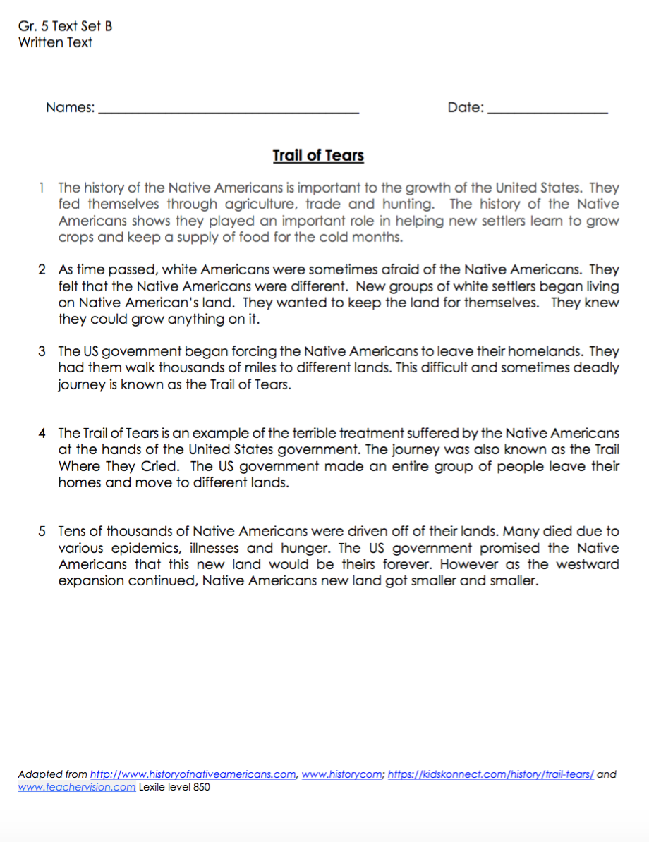

CLOSE READING – THREE READS
We will read the text three times; each time with a specific purpose.
1st read – Find key ideas and details
  What do you notice in the written text?
2nd read – Paraphrase the text
  How can you say it in your own words?
3rd read – Identify evidence in the text to support your ideas
  What details can you cite to CLARIFY and FORTIFY your ideas?
CLOSE READING – THREE READS
Notes:
DISTRIBUTE TEXT.
We will read the text three times; each time with a specific purpose.
1st read – Find key ideas and details
What do you notice in the written text?
2nd read – Paraphrase the text
How can you say it in your own words?
3rd read – Identify evidence in the text to support your ideas
What details can you cite to CLARIFY and FORTIFY your ideas?

Slide 46
THREE READS – 1st READ
1st read – Find key ideas and details
  What do you notice in the written text?
Listen actively as I read the text aloud to you. I will stop at key places in the text for you to:
Mark a star for each key idea
Underline supporting details
THREE READS—1ST READ
Notes:
First Read: Key Ideas and Details
Set the purpose for reading and have students read text as independently as possible. Depending on the text complexity and the students, the first read may be done independently, as a read aloud/think aloud, or paired or shared reading.
The first read should be without building background; students should be integrating their background knowledge and knowledge gained from the visual texts, as they read the written text. Focus on the key ideas and details in the text, making sure that students know the main idea and key details from the text.
Teacher models think aloud and annotating a section of the text for key ideas and details. Students, in pairs, annotate the remainder of the text. Students work in pairs to annotate their texts for main idea and key details.
Teacher uses document reader to project text and debriefs with whole class. Teacher reads aloud each sentence and then asks pairs of students to explain how and why they annotated the sentence.

Slide 47
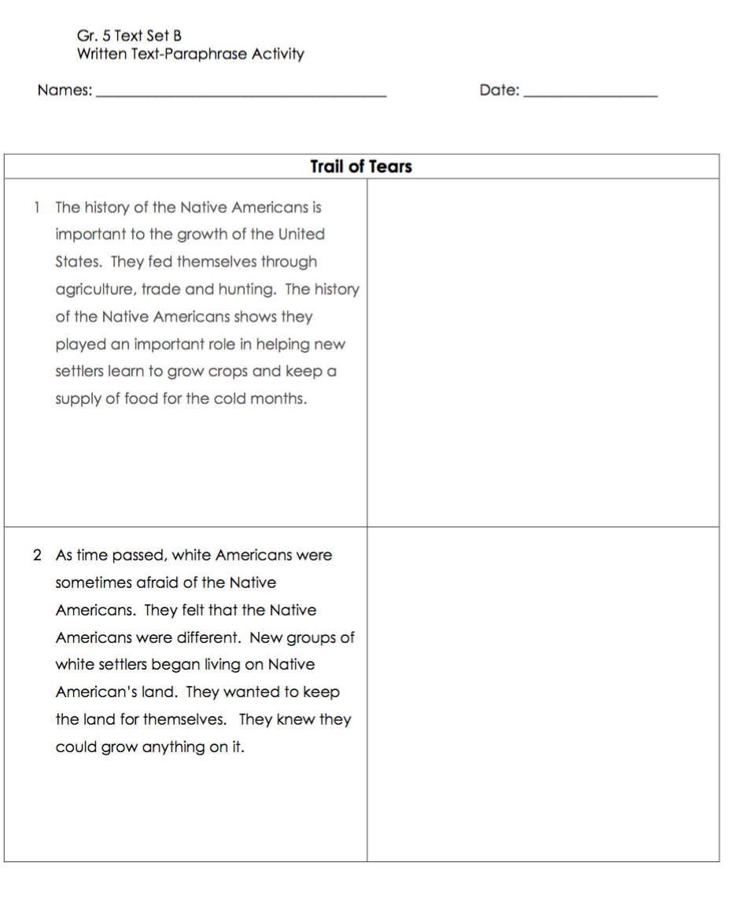
THREE READS – 2nd READ
2nd read – Paraphrase the text
  How can you say it in your own words?
Each pair number off 1-5.
You will work with your partner to paraphrase your assigned section.
  Make sure to state all ideas in your own words.
Let’s look at an example…
Americans were afraid of the Native Americans because they were different from them.
THREE READS—2nd READ
Notes:
2nd Read - Paraphrasing
Set the purpose for this activity. Students will review the text a section at a time in order to paraphrase the content. Teacher distributes Paraphrasing Texts activity sheet to pairs. Teacher models how to paraphrase the same section of that text that was used to model annotating the text. Pairs work collaboratively to paraphrase sections of the text and complete activity sheet

Slide 48
THREE READS – 2nd READ
2nd read – Paraphrase the text
  How can you say it in your own words?
Form expert groups:
  All 1s, 2s, 3s, 4s, and 5s
You will work with your expert group to finalize how you will paraphrase your assigned section
  Listen actively as each pair reads their paraphrase
  Collaborate and come to consensus to chart your paraphrase as an expert group
Be ready to share out with the class
Americans were afraid of the Native Americans because they were different from them.
THREE READS—2nd READ
Notes:
2nd Read - Paraphrasing
Set the purpose for this activity. Pairs will form Expert Groups to share how they paraphrased, make any changes if necessary.
Teacher supports Expert Groups.

Slide 49
THREE READS – 2nd READ
2nd read – Paraphrase the text
  How can you say it in your own words?
Listen actively as each expert team shares out their charted paraphrase.
  1s
  2s
  3s
  4s
  5s
Annotate the ideas on your own paper.
THREE READS—2nd READ
Notes:
2nd Read - Paraphrasing
Teacher debriefs with whole class by asking for each Expert Group to present how they paraphrased. The rest of the students listen actively and take notes on their paper.

Slide 50
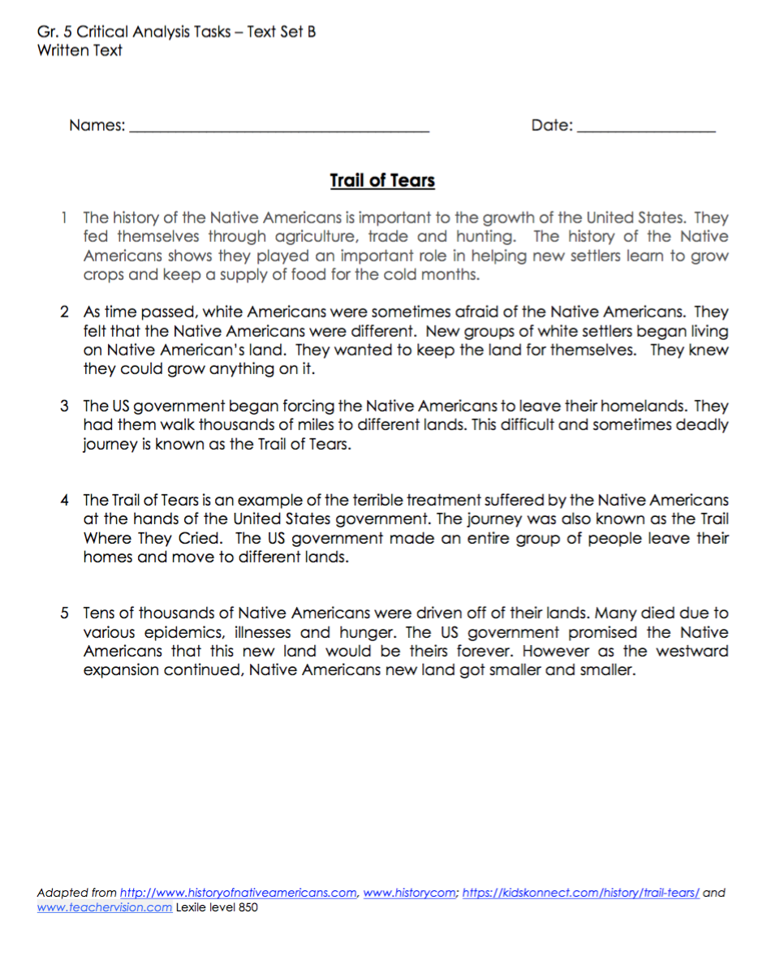
THREE READS – 3rd READ
3rd read – Identify evidence in the text to support your ideas
  What four ideas did you notice in the written text? Cite details to CLARIFY and FORTIFY your ideas
You will each work with your partner to re-read the text and discuss what you notice.
This time, focus on citing specific details to CLARIFY and FORTIFY your ideas.
  Use a highlighter to highlight the evidence
THREE READS—3rd READ
Notes:
Paraphrasing
Set the purpose for this activity. Students will review the text a section at a time in order to find four ideas in the text.

Slide 51
Artifacts Folder
Trail of Tears
✓
✓
Trail of Tears
✓
✓
Place your Written Text and Paraphrase the Text Activity in your Artifacts Folder
Use the checklist to mark each task as you complete it
Notes:
Remind students to keep her/his artifacts in their artifacts folder

Slide 52
REVIEW ELD OBJECTIVE & SELF-ASSESS
In this lesson, you…
  read a text closely three times
  had a Constructive Conversation with a partner
  collaborated with a partner to paraphrase a written text
  added to your artifacts folder
Think…
    How did paraphrasing help you understand the text?
Work with your Constructive Conversation partner to:
Identify one thing that you did well and one thing you want to improve
Share and explain to your partner
TURN & TALK
TURN & TALK - THEN WHOLE GROUP DISCUSSION
Notes:
After students have had a few minutes to discuss with a partner, call on one or two individuals to share out with the whole group.

Slide 53
Interacting with Written Text
LESSON 4B

Slide 54
ELD OBJECTIVE
In this lesson, you will...
  listen actively to a Model Constructive Conversation about a written text
  have a Constructive Conversation with a partner
  collaborate with a partner to take notes using a graphic organizer
  add to your artifacts folder
STUDENT FRIENDLY ELD OBJECTIVES
Notes:
COMMUNICATE THE PURPOSE OF THE LESSON - SHARE LESSON OBJECTIVES WITH STUDENTS

Slide 55
  Use your think time to study the written text.
  Review your artifacts from the Three Reads lesson.
  What do you notice in the written text? Cite details to CLARIFY and FORTIFY your ideas
  Prompt: What do you notice? Make connections across the visual texts. Cite details to CLARIFY and FORTIFY your ideas.
Notes:
Review your artifacts from the Three Reads lesson
What do you notice in the written text? Cite details to CLARIFY and FORTIFY your ideas?

Slide 56
Note -Taking Graphic Organizer
Written Text – Trail of Tears
You and your partner will think about the ideas you discussed during your Constructive Conversation
You must agree on the four strongest ideas
Each of you will write the same four ideas on your copy of the Graphic Organizer
MODEL – REVIEW THE CONVERSATION PATTERN
Notes:
GUIDE STUDENTS THROUGH STEP 1 OF THE GRAPHIC ORGANIZER. STUDENTS SHOULD COLLABORATE AND DISCUSS THEIR ANSWERS BEFORE WRITING THEM DOWN ON THEIR PAPERS.

Slide 57
Note-Taking Graphic Organizer
Written Text – Trail of Tears
What do the four ideas you selected make you think? Talk to your partner
You must agree on how to complete the following sentence starter:
  We think…
Each of you will write the same response on your copy of the Graphic Organizer
MODEL – NOTE-TAKING SKILLS
Notes:
GUIDE STUDENTS THROUGH STEP 2 OF THE GRAPHIC ORGANIZER. STUDENTS SHOULD COLLABORATE AND DISCUSS THEIR ANSWERS BEFORE WRITING THEM DOWN ON THEIR PAPERS.

Slide 58
Note-Taking Graphic Organizer
Written Text – Trail of Tears
Return to the texts and find evidence that supports each idea
You must agree on the evidence and provide an explanation
Each of you will write the same response on your copy of the Graphic Organizer
MODEL – NOTE-TAKING SKILLS
Notes:
GUIDE STUDENTS THROUGH STEP 3 OF THE GRAPHIC ORGANIZER. STUDENTS SHOULD COLLABORATE AND DISCUSS THEIR ANSWERS BEFORE WRITING THEM DOWN ON THEIR PAPERS.

Slide 59
Note-Taking Graphic Organizer
Written Text – Trail of Tears
How does the evidence modify your thinking? What do you think now?
Turn and talk to your partner
You must agree on how to complete the following sentence starter:
  We now think…
Each of you will write the same response on your copy of the Graphic Organizer
MODEL – NOTE-TAKING SKILLS
Notes:
GUIDE STUDENTS THROUGH STEP 4 OF THE GRAPHIC ORGANIZER. STUDENTS SHOULD COLLABORATE AND DISCUSS THEIR ANSWERS BEFORE WRITING THEM DOWN ON THEIR PAPERS.

Slide 60
Note-Taking
Graphic Organizer
Written Text – Trail of Tears
Based on the evidence from the written text, what can you conclude?
Turn and talk to your partner
You must agree on how to complete the following sentence starter:
  Based on the evidence from the written text, we can conclude that…
Each of you will write the same response on your copy of the Graphic Organizer
MODEL – NOTE-TAKING SKILLS
Notes:
GUIDE STUDENTS THROUGH STEP 5 OF THE GRAPHIC ORGANIZER. STUDENTS SHOULD COLLABORATE AND DISCUSS THEIR ANSWERS BEFORE WRITING THEM DOWN ON THEIR PAPERS.

Slide 61
Note-Taking
Graphic Organizer
Written Text – Trail of Tears
What questions do you have?
Turn and talk to your partner
You must agree on how to complete the following sentence starter:
  A question we now have is…
Each of you will write the same response on your copy of the Graphic Organizer
MODEL – NOTE-TAKING SKILLS
Notes:
GUIDE STUDENTS THROUGH STEP 6 OF THE GRAPHIC ORGANIZER. STUDENTS SHOULD COLLABORATE AND DISCUSS THEIR ANSWERS BEFORE WRITING THEM DOWN ON THEIR PAPERS.

Slide 62
Listen Actively
Number off from 1-4
Each of you will listen actively for one specific criterion:
  1s – How does each partner accurately address the prompt throughout the entire conversation?
  2s - How does each partner combine ideas across texts?
  3s - How does each partner provide multiple examples of evidence ?
  4s - How does each partner utilize academic and domain specific vocabulary – precise language?
PREPARE FOR ACTIVE LISTENING
Notes:
Review the Listening Task Poster and assign each student a focus to prepare for Active Listening

Slide 63
Listen to the Model
#1
#2
#3
#4
Prompt: How does the written text CLARIFY & FORTIFY your thinking of the previous texts?
Notes:
STUDENTS SHOULD LISTEN ACTIVELY TO THE MODEL CONSTRUCTIVE CONVERSATION

Slide 64
What makes this a Model Constructive Conversation?
SHARE OUT
Let’s share out your findings.
Each of you listened actively for one specific criterion:
  1s – How did each partner accurately address the prompt throughout the entire conversation?
  2s - How did each partner combine ideas across texts?
  3s - How did each partner provide multiple examples of evidence ?
  4s - How did each partner utilize academic and domain specific vocabulary – precise language?
DEBRIEF THE MODEL
Notes:
DEBRIEF THE MODEL
Let’s share out your findings.
Each of you listened actively for one specific criterion:
1s – How did each partner accurately address the prompt throughout the entire conversation?
2s - How did each partner combine ideas across texts?
3s - How did each partner provide multiple examples of evidence ?
4s - How did each partner utilize academic and domain specific vocabulary – precise language?

Slide 65
Prepare to Have a Constructive Conversation
Stand Up – Look for a partner
Hand Up – Raise one hand in the air and walk across the room to find a partner
Pair Up – Connect your hand with your partner
STAND UP, HAND UP, PAIR UP STRATEGY
Notes:
Show how to use the Stand Up, Hand Up, Pair Up Strategy to find a new partner. Model looking standing up (Stand Up), raising one hand in the air (Hand Up), and walking across the room to find a partner (Pair Up). Demonstrate how to connect your hand to your partner’s hand to confirm that you’ve selected each other. Have students do the same.

Slide 66
Student Practice
Constructive Conversation
#1
#2
#3
#4
Prompt: How does the written text CLARIFY & FORTIFY your thinking of the previous texts?
Notes:
MAKE SURE STUDENTS HAVE ALL TEXTS TO REFER TO AS THEY HAVE A CONSTRUCTIVE CONVERSATION WITH THEIR PARTNER.

Slide 67
CONSTRUCTIVE CONVERSATION FISHBOWL MODEL
PROMPT:
How does this written text CLARIFY & FORTIFY your thinking of the previous texts?
Listen actively as two of your peers model how to have a Constructive Conversation
#1
#2
#3
#4
FORMATIVE ASSESSMENT– TEACHER COLLECTS LANGUAGE SAMPLE SPF 2.0
Notes:
Select two students to Fishbowl Model a Constructive Conversation in front of the class. Collect a language sample from the two students using the SPF 2.0. The language sample must be at least four turns in length.

Slide 68
DEBRIEF THE FISHBOWL MODEL
PROMPT:
How does this written text CLARIFY & FORTIFY your thinking of the previous texts?
TURN & TALK
DEBRIEF THE FISHBOWL MODEL
Notes:
USE THE LISTENING TASK POSTER TO DEBRIEF THE FISHBOWL MODEL WITH STUDENTS AND PROVIDE FEEDBACK

Slide 69
Artifacts Folder
Trail of Tears
✓
✓
✓
Trail of Tears
✓
Place your Note-Taking Graphic Organizer in your artifacts folder
Use the checklist to mark each task as you complete it
✓
Notes:
Remind students to keep her/his artifacts in their artifacts folder

Slide 70

REVIEW ELD OBJECTIVE & SELF-ASSESS
In this lesson, you…
  listened actively to a Model Constructive Conversation about written text
  had a Constructive Conversation with a partner
  collaborated with a partner to take notes using a graphic organizer
  added to your artifacts folder
Think…
    What helped you accurately address the prompt?
Work with your Constructive Conversation partner to:
Identify one thing that you did well and one thing you want to improve
Share and explain to your partner
TURN & TALK
TURN & TALK - THEN WHOLE GROUP DISCUSSION
Notes:
After students have had a few minutes to discuss with a partner, call on one or two individuals to share out with the whole group.

Slide 71
Interacting with Song and Lyrics Text
LESSON 5B

Slide 72
ELD OBJECTIVE
In this lesson, you will...
  listen actively to a Model Constructive Conversation about song and lyrics text
  have a Constructive Conversation with a partner
  collaborate with a partner to take notes using a graphic organizer
  add to your artifacts folder
STUDENT FRIENDLY ELD OBJECTIVES
Notes:
COMMUNICATE THE PURPOSE OF THE LESSON - SHARE LESSON OBJECTIVES WITH STUDENTS

Slide 73
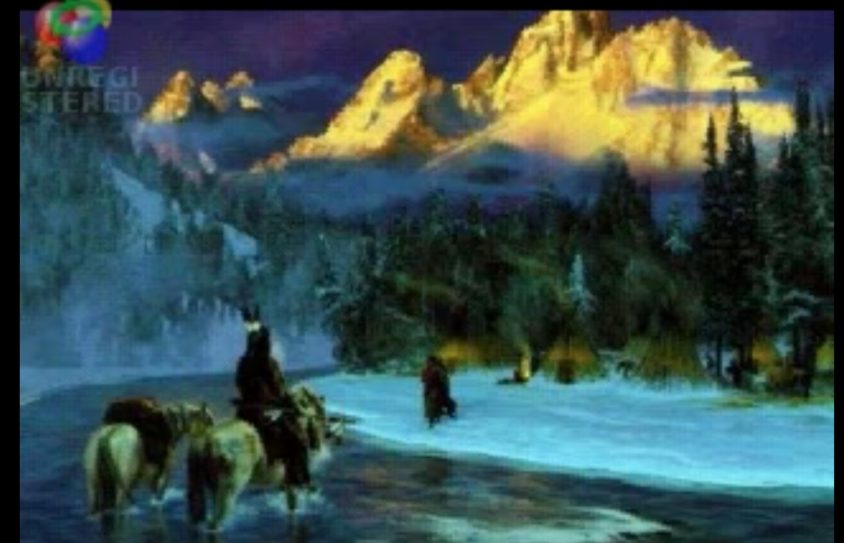
Trail of Tears by John Denver
Prompt: How do the song and lyrics CLARIFY & FORTIFY your thinking of the previous texts?

Slide 74
Note-Taking Graphic Organizer
Song & Lyrics – Trail of Tears
You and your partner will think about the ideas you discussed during your Constructive Conversation
You must agree on the four strongest ideas
Each of you will write the same four ideas on your copy of the Graphic Organizer
MODEL – REVIEW THE CONVERSATION PATTERN
Notes:
GUIDE STUDENTS THROUGH STEP 1 OF THE GRAPHIC ORGANIZER. STUDENTS SHOULD COLLABORATE AND DISCUSS THEIR ANSWERS BEFORE WRITING THEM DOWN ON THEIR PAPERS.

Slide 75
Note-Taking Graphic Organizer
Song & Lyrics – Trail of Tears
What do the four ideas you selected make you think? Talk to your partner
You must agree on how to complete the following sentence starter:
  We think…
Each of you will write the same response on your copy of the Graphic Organizer
MODEL – NOTE-TAKING SKILLS
Notes:
GUIDE STUDENTS THROUGH STEP 2 OF THE GRAPHIC ORGANIZER. STUDENTS SHOULD COLLABORATE AND DISCUSS THEIR ANSWERS BEFORE WRITING THEM DOWN ON THEIR PAPERS.

Slide 76
Note-Taking Graphic Organizer
Song & Lyrics – Trail of Tears
Return to the texts and find evidence that supports each idea
You must agree on the evidence and provide an explanation
Each of you will write the same response on your copy of the Graphic Organizer
MODEL – NOTE-TAKING SKILLS
Notes:
GUIDE STUDENTS THROUGH STEP 3 OF THE GRAPHIC ORGANIZER. STUDENTS SHOULD COLLABORATE AND DISCUSS THEIR ANSWERS BEFORE WRITING THEM DOWN ON THEIR PAPERS.

Slide 77
Note-Taking Graphic Organizer
Song & Lyrics – Trail of Tears
How does the evidence modify your thinking? What do you think now?
Turn and talk to your partner
You must agree on how to complete the following sentence starter:
  We now think…
Each of you will write the same response on your copy of the Graphic Organizer
MODEL – NOTE-TAKING SKILLS
Notes:
GUIDE STUDENTS THROUGH STEP 4 OF THE GRAPHIC ORGANIZER. STUDENTS SHOULD COLLABORATE AND DISCUSS THEIR ANSWERS BEFORE WRITING THEM DOWN ON THEIR PAPERS.

Slide 78
Note-Taking
Graphic Organizer
Song & Lyrics – Trail of Tears
Based on the evidence from the song and lyrics, what can you conclude?
Turn and talk to your partner
You must agree on how to complete the following sentence starter:
  Based on the evidence from the song and lyrics, we can conclude that…
Each of you will write the same response on your copy of the Graphic Organizer
MODEL – NOTE-TAKING SKILLS
Notes:
GUIDE STUDENTS THROUGH STEP 5 OF THE GRAPHIC ORGANIZER. STUDENTS SHOULD COLLABORATE AND DISCUSS THEIR ANSWERS BEFORE WRITING THEM DOWN ON THEIR PAPERS.

Slide 79
Note-Taking
Graphic Organizer
Song & Lyrics – Trail of Tears
What questions do you have?
Turn and talk to your partner
You must agree on how to complete the following sentence starter:
  A question we now have is…
Each of you will write the same response on your copy of the Graphic Organizer
MODEL – NOTE-TAKING SKILLS
Notes:
GUIDE STUDENTS THROUGH STEP 6 OF THE GRAPHIC ORGANIZER. STUDENTS SHOULD COLLABORATE AND DISCUSS THEIR ANSWERS BEFORE WRITING THEM DOWN ON THEIR PAPERS.

Slide 80
Listen Actively
Number off from 1-4
Each of you will listen actively for one specific criterion:
  1s – How does each partner accurately address the prompt throughout the entire conversation?
  2s - How does each partner combine ideas across texts?
  3s - How does each partner provide multiple examples of evidence ?
  4s - How does each partner utilize academic and domain specific vocabulary – precise language?
PREPARE FOR ACTIVE LISTENING
Notes:
Review the Listening Task Poster and assign each student a focus to prepare for Active Listening

Slide 81
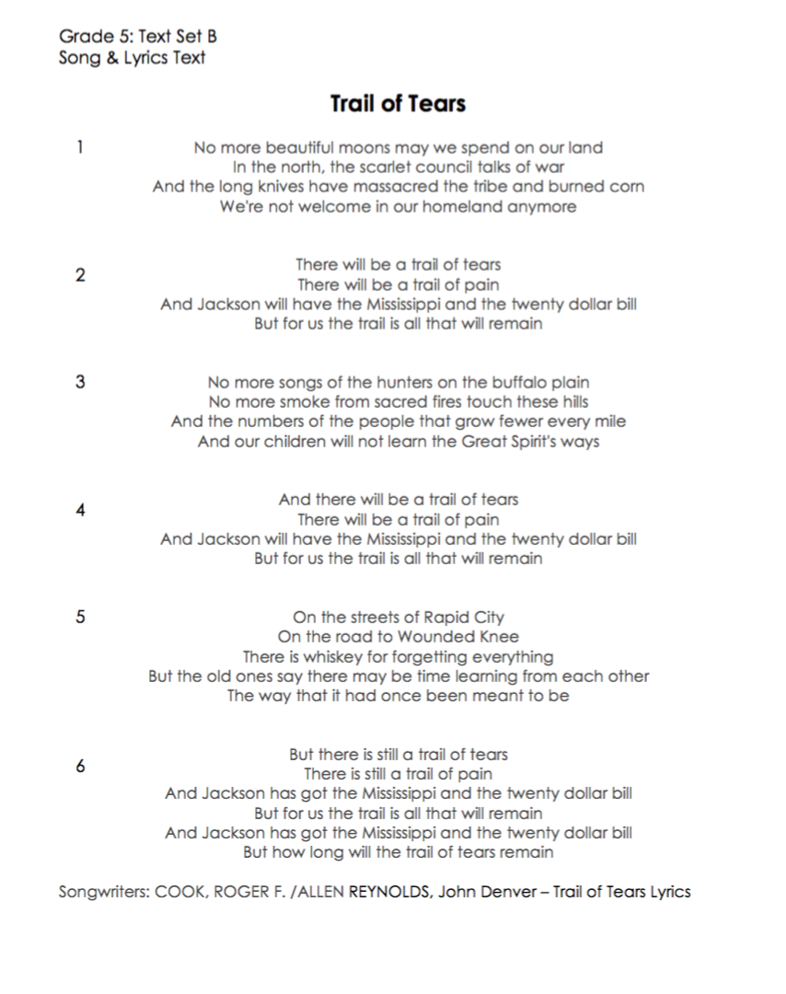
Listen to
the Model
#1
#2
#3
#4
Prompt: How do the song and lyrics CLARIFY & FORTIFY your thinking of the previous texts?
Notes:
STUDENTS SHOULD LISTEN ACTIVELY TO THE MODEL CONSTRUCTIVE CONVERSATION

Slide 82
What makes this a Model Constructive Conversation?
SHARE OUT
Let’s share out your findings.
Each of you listened actively for one specific criterion:
  1s – How did each partner accurately address the prompt throughout the entire conversation?
  2s - How did each partner combine ideas across texts?
  3s - How did each partner provide multiple examples of evidence ?
  4s - How did each partner utilize academic and domain specific vocabulary – precise language?
DEBRIEF THE MODEL
Notes:
DEBRIEF THE MODEL
Let’s share out your findings.
Each of you listened actively for one specific criterion:
1s – How did each partner accurately address the prompt throughout the entire conversation?
2s - How did each partner combine ideas across texts?
3s - How did each partner provide multiple examples of evidence ?
4s - How did each partner utilize academic and domain specific vocabulary – precise language?

Slide 83
Prepare to Have a Constructive Conversation
Stand Up – Look for a partner
Hand Up – Raise one hand in the air and walk across the room to find a partner
Pair Up – Connect your hand with your partner
STAND UP, HAND UP, PAIR UP STRATEGY
Notes:
Show how to use the Stand Up, Hand Up, Pair Up Strategy to find a new partner. Model looking standing up (Stand Up), raising one hand in the air (Hand Up), and walking across the room to find a partner (Pair Up). Demonstrate how to connect your hand to your partner’s hand to confirm that you’ve selected each other. Have students do the same.

Slide 84
Student Practice
Constructive Conversation
#1
#2
#3
#4
Prompt: How do the song and lyrics CLARIFY & FORTIFY your thinking of the previous texts?
Notes:
MAKE SURE STUDENTS HAVE ALL TEXTS TO REFER TO AS THEY HAVE A CONSTRUCTIVE CONVERSATION WITH THEIR PARTNER.

Slide 85
CONSTRUCTIVE CONVERSATION FISHBOWL MODEL
PROMPT:
How do the written text CLARIFY & FORTIFY your thinking of the previous texts?
Listen actively as two of your peers model how to have a Constructive Conversation
#1
#2
#3
#4
FORMATIVE ASSESSMENT– TEACHER COLLECTS LANGUAGE SAMPLE SPF 2.0
Notes:
Select two students to Fishbowl Model a Constructive Conversation in front of the class. Collect a language sample from the two students using the SPF 2.0. The language sample must be at least four turns in length.

Slide 86
DEBRIEF THE FISHBOWL MODEL
PROMPT:
How do the written text CLARIFY & FORTIFY your thinking of the previous texts?
TURN & TALK
DEBRIEF THE FISHBOWL MODEL
Notes:
USE THE LISTENING TASK POSTER TO DEBRIEF THE FISHBOWL MODEL WITH STUDENTS AND PROVIDE FEEDBACK

Slide 87
Artifacts Folder
Trail of Tears
✓
✓
✓
Trail of Tears
✓
Place your Note-Taking Graphic Organizer in your Artifacts Folder
Use the checklist to mark each task as you complete it
✓
✓
✓
Notes:
Remind students to keep her/his artifacts in their artifacts folder

Slide 88
REVIEW ELD OBJECTIVE & SELF-ASSESS
In this lesson, you…
  listened actively to a Model Constructive Conversation about song and lyrics text
  had a Constructive Conversation with a partner
  collaborated with a partner to take notes using a graphic organizer
  added to your artifacts folder
Think…
    What helped you accurately address the prompt?
Work with your Constructive Conversation partner to:
Identify one thing that you did well and one thing you want to improve
Share and explain to your partner
TURN & TALK
TURN & TALK - THEN WHOLE GROUP DISCUSSION
Notes:
After students have had a few minutes to discuss with a partner, call on one or two individuals to share out with the whole group.

Slide 89
Interacting with Video Text
LESSON 6B

Slide 90
ELD OBJECTIVE
In this lesson, you will...
  listen actively to a Model Constructive Conversation about video
  have a Constructive Conversation with a partner
  collaborate with a partner to take notes using a graphic organizer
  add to your artifacts folder
STUDENT FRIENDLY ELD OBJECTIVES
Notes:
COMMUNICATE THE PURPOSE OF THE LESSON - SHARE LESSON OBJECTIVES WITH STUDENTS

Slide 91

Trail of Tears Video
Prompt: How does the video CLARIFY & FORTIFY your thinking of the previous texts?

Slide 92
Note-Taking Graphic Organizer
Video – Trail of Tears
You and your partner will think about the ideas you discussed during your Constructive Conversation
You must agree on the four strongest ideas
Each of you will write the same four ideas on your copy of the Graphic Organizer
MODEL – REVIEW THE CONVERSATION PATTERN
Notes:
GUIDE STUDENTS THROUGH STEP 1 OF THE GRAPHIC ORGANIZER. STUDENTS SHOULD COLLABORATE AND DISCUSS THEIR ANSWERS BEFORE WRITING THEM DOWN ON THEIR PAPERS.

Slide 93
Note-Taking Graphic Organizer
Video – Trail of Tears
What do the four ideas you selected make you think? Talk to your partner
You must agree on how to complete the following sentence starter:
  We think…
Each of you will write the same response on your copy of the Graphic Organizer
MODEL – NOTE-TAKING SKILLS
Notes:
GUIDE STUDENTS THROUGH STEP 2 OF THE GRAPHIC ORGANIZER. STUDENTS SHOULD COLLABORATE AND DISCUSS THEIR ANSWERS BEFORE WRITING THEM DOWN ON THEIR PAPERS.

Slide 94
Note-Taking Graphic Organizer
Video – Trail of Tears
Return to the video and find evidence that supports each idea
You must agree on the evidence and provide an explanation
Each of you will write the same response on your copy of the Graphic Organizer
MODEL – NOTE-TAKING SKILLS
Notes:
GUIDE STUDENTS THROUGH STEP 3 OF THE GRAPHIC ORGANIZER. STUDENTS SHOULD COLLABORATE AND DISCUSS THEIR ANSWERS BEFORE WRITING THEM DOWN ON THEIR PAPERS.

Slide 95
Note-Taking Graphic Organizer
Video – Trail of Tears
How does the evidence modify your thinking? What do you think now?
Turn and talk to your partner
You must agree on how to complete the following sentence starter:
  We now think…
Each of you will write the same response on your copy of the Graphic Organizer
MODEL – NOTE-TAKING SKILLS
Notes:
GUIDE STUDENTS THROUGH STEP 4 OF THE GRAPHIC ORGANIZER. STUDENTS SHOULD COLLABORATE AND DISCUSS THEIR ANSWERS BEFORE WRITING THEM DOWN ON THEIR PAPERS.

Slide 96
Note-Taking
Graphic Organizer
Video – Trail of Tears
Based on the evidence from the video , what can you conclude?
Turn and talk to your partner
You must agree on how to complete the following sentence starter:
  Based on the evidence from the video, we can conclude that…
Each of you will write the same response on your copy of the Graphic Organizer
MODEL – NOTE-TAKING SKILLS
Notes:
GUIDE STUDENTS THROUGH STEP 5 OF THE GRAPHIC ORGANIZER. STUDENTS SHOULD COLLABORATE AND DISCUSS THEIR ANSWERS BEFORE WRITING THEM DOWN ON THEIR PAPERS.

Slide 97
Note-Taking
Graphic Organizer
Video – Trail of Tears
What questions do you have?
Turn and talk to your partner
You must agree on how to complete the following sentence starter:
  A question we now have is…
Each of you will write the same response on your copy of the Graphic Organizer
MODEL – NOTE-TAKING SKILLS
Notes:
GUIDE STUDENTS THROUGH STEP 6 OF THE GRAPHIC ORGANIZER. STUDENTS SHOULD COLLABORATE AND DISCUSS THEIR ANSWERS BEFORE WRITING THEM DOWN ON THEIR PAPERS.

Slide 98
Listen Actively
Number off from 1-4
Each of you will listen actively for one specific criterion:
  1s – How does each partner accurately address the prompt throughout the entire conversation?
  2s - How does each partner combine ideas across texts?
  3s - How does each partner provide multiple examples of evidence ?
  4s - How does each partner utilize academic and domain specific vocabulary – precise language?
PREPARE FOR ACTIVE LISTENING
Notes:
Review the Listening Task Poster and assign each student a focus to prepare for Active Listening

Slide 99
Listen to
the Model
#1
#2
Trail of Tears Video
#3
#4
Prompt: How does the video CLARIFY & FORTIFY your thinking of the previous texts?
Notes:
STUDENTS SHOULD LISTEN ACTIVELY TO THE MODEL CONSTRUCTIVE CONVERSATION

Slide 100
What makes this a Model Constructive Conversation?
SHARE OUT
Let’s share out your findings.
Each of you listened actively for one specific criterion:
  1s – How did each partner accurately address the prompt throughout the entire conversation?
  2s - How did each partner combine ideas across texts?
  3s - How did each partner provide multiple examples of evidence ?
  4s - How did each partner utilize academic and domain specific vocabulary – precise language?
DEBRIEF THE MODEL
Notes:
DEBRIEF THE MODEL
Let’s share out your findings.
Each of you listened actively for one specific criterion:
1s – How did each partner accurately address the prompt throughout the entire conversation?
2s - How did each partner combine ideas across texts?
3s - How did each partner provide multiple examples of evidence ?
4s - How did each partner utilize academic and domain specific vocabulary – precise language?

Slide 101
Prepare to Have a Constructive Conversation
Stand Up – Look for a partner
Hand Up – Raise one hand in the air and walk across the room to find a partner
Pair Up – Connect your hand with your partner
STAND UP, HAND UP, PAIR UP STRATEGY
Notes:
Show how to use the Stand Up, Hand Up, Pair Up Strategy to find a new partner. Model looking standing up (Stand Up), raising one hand in the air (Hand Up), and walking across the room to find a partner (Pair Up). Demonstrate how to connect your hand to your partner’s hand to confirm that you’ve selected each other. Have students do the same.

Slide 102
Student Practice
Constructive Conversation
#1
#2
Trail of Tears Video
#3
#4
Prompt: How does the video CLARIFY & FORTIFY your thinking of the previous texts?
Notes:
MAKE SURE STUDENTS HAVE ALL TEXTS TO REFER TO AS THEY HAVE A CONSTRUCTIVE CONVERSATION WITH THEIR PARTNER.

Slide 103
CONSTRUCTIVE CONVERSATION FISHBOWL MODEL
PROMPT:
How does the video CLARIFY & FORTIFY your thinking of the previous texts?
Listen actively as two of your peers model how to have a Constructive Conversation
#1
#2
Trail of Tears Video
#3
#4
FORMATIVE ASSESSMENT– TEACHER COLLECTS LANGUAGE SAMPLE SPF 2.0
Notes:
Select two students to Fishbowl Model a Constructive Conversation in front of the class. Collect a language sample from the two students using the SPF 2.0. The language sample must be at least four turns in length.

Slide 104
DEBRIEF THE FISHBOWL MODEL
PROMPT:
How does the video CLARIFY & FORTIFY your thinking of the previous texts?
TURN & TALK
Trail of Tears Video
DEBRIEF THE FISHBOWL MODEL
Notes:
USE THE LISTENING TASK POSTER TO DEBRIEF THE FISHBOWL MODEL WITH STUDENTS AND PROVIDE FEEDBACK

Slide 105
Artifacts Folder
Trail of Tears
✓
✓
✓
Trail of Tears
✓
Place your Note-Taking Graphic Organizer in your Artifacts Folder
Use the checklist to mark each task as you complete it
✓
✓
✓
✓
Notes:
Remind students to keep her/his artifacts in their artifacts folder

Slide 106

REVIEW ELD OBJECTIVE & SELF-ASSESS
In this lesson, you…
  listened actively to a Model Constructive Conversation about video text
  had a Constructive Conversation with a partner
  collaborated with a partner to take notes using a graphic organizer
  added to your artifacts folder
Think…
    What helped you connect ideas across texts?
Work with your Constructive Conversation partner to:
Identify one thing that you did well and one thing you want to improve
Share and explain to your partner
TURN & TALK
TURN & TALK - THEN WHOLE GROUP DISCUSSION
Notes:
After students have had a few minutes to discuss with a partner, call on one or two individuals to share out with the whole group.

